Slide 1

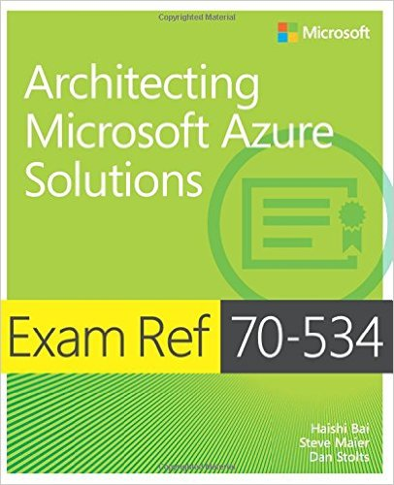




Datacenter Transformation to the Cloud
Technical Overview: Migrating Apps, Workloads, and Data to Azure
Dan Stolts (@ITProGuru) Chief Technology Strategist Microsoft – Commercial Software Engineering Blog: ITProGuru.com
dstolts@Microsoft.com
www.linkedin.com/in/danstolts
+Exam Ref 70-535
Slides: http://github.com/dstolts/resources
Notes:
Title of Presentation: Datacenter Transformation to the Cloud
Abstract (max 500 spaces): Do you need help making since of the “best” way to migrate your workloads to the cloud? If so, this session is for you. You will learn how you can leverage free tools and best practices for migrating workloads to the Cloud. Whether you have on-premises VM’s, web apps, structured data, unstructured data, files, or anything else, there are things you should know to before your next cloud migration. Did you know that you can limit downtime by literally “failing over” from on-premises to the cloud? Did you know your applications can likely be shifted from VMs to platform services with little or no work? Did you know there are significant cost differences between offerings which can save you money $$$ by doing it right; the first time? Regardless of your preference, lift-n-shift, sync-&-fail-over, optimize migrate, or standardize and future proof your workloads, you will get the information you need to start or continue your move to the cloud.
Name of Presenter: Dan Stolts, Chief Technology Strategist, Microsoft
Bio of Presenter (max 500 spaces):
Dan Stolts “ITProGuru” is a technology expert who is a Master of Systems Management, DevOps and Cloud Technologies. He is Chief Technology Strategist for Microsoft, owns several businesses and is a published author. Reach him on his primary blog http://itproguru.com or twitter @ITProGuru. He is a proven leader of teams, people and projects. He holds many certifications including MCT, MCITP, MCSE, TS, etc. Dan is currently specializing in DevOps and cloud technologies. Dan is and has been a highly active member of the user group community. Dan is an enthusiastic advocate of technology and is passionate about helping others. See more at: http://itproguru.com/about
Form Submitted by: Dan Stolts
Date: December 21, 2017

Slide 2

Migration realities
What’s getting in the way?
Accurate cost analysis of cloud versus on-premises
It’s too complicated—where even to begin?
Upskilling…
http://aka.ms/certup
Keeping the business running without downtime
Notes:
Migration to the cloud should be a well-planned journey, with well-defined milestones along the way. Without a strong plan, risks can include a complex and time-consuming process compounded by a lack of relevant skills, loss of control by moving computer resources off-premises, concerns about bandwidth, and unexpected costs. Microsoft has partners and a well-defined migration process, along with software tools, to ease this risk.

Slide 3
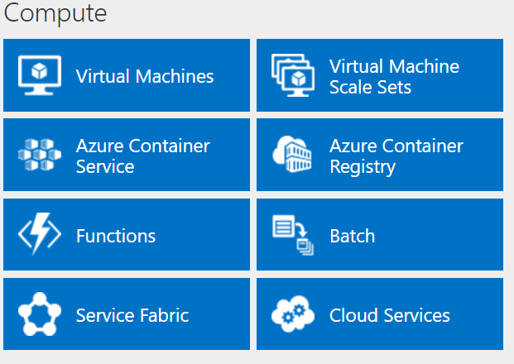
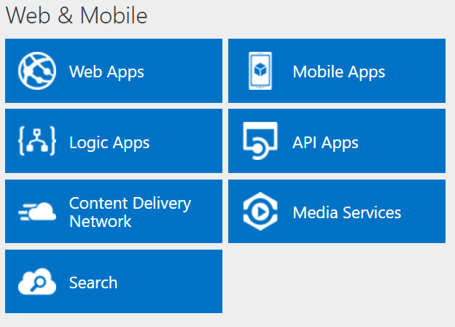
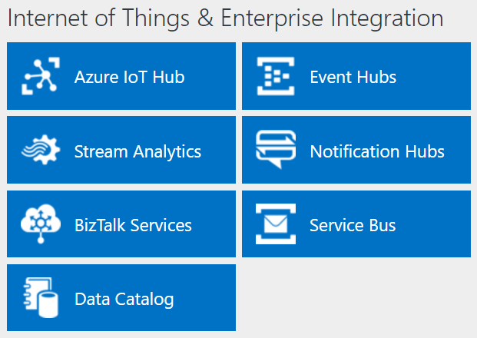
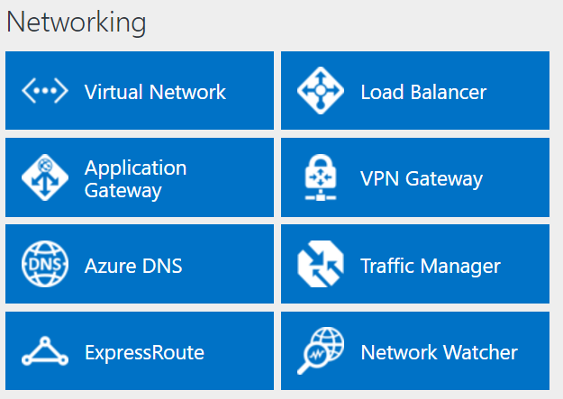
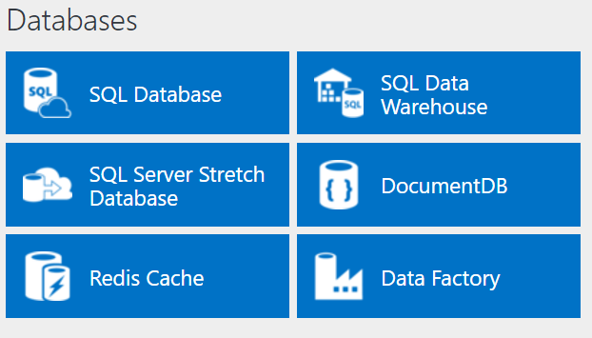
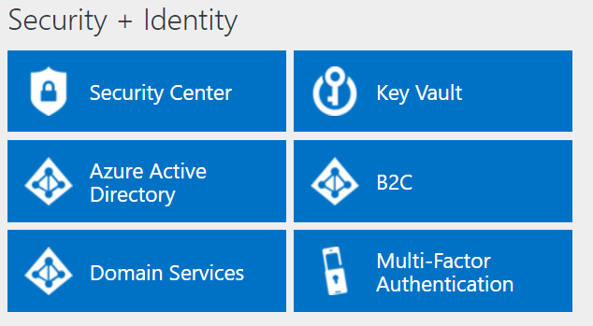
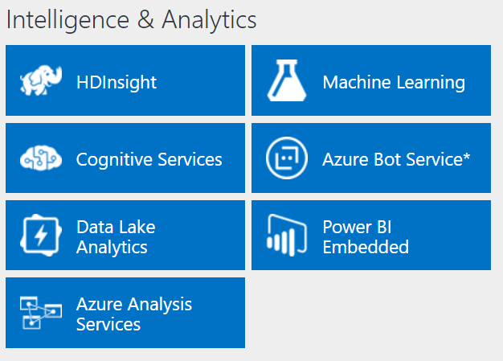
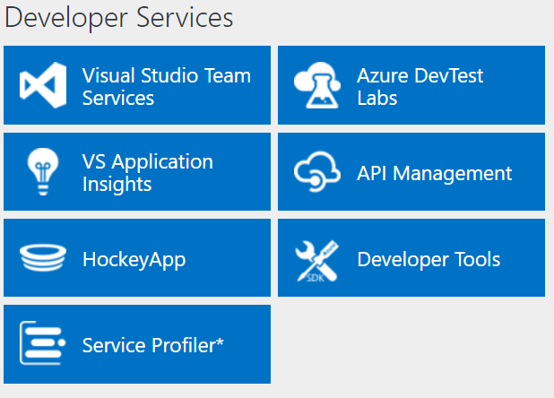
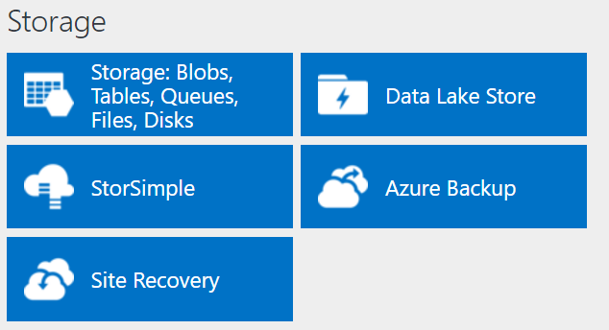
http://azureplatform.azurewebsites.net/
* Preview Services
Notes:
Preview Version 1.7 (2017-04-20)

Slide 4

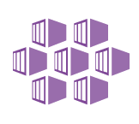



Azure: The Power Of Choice
Compute
Virtual Machines
Container Service
Service Fabric
App Service
Functions
More Control
Focus on the App
Customer-managed
(IaaS)
Platform-managed
(PaaS)
Code-only
(serverless)
Notes:
Azure provides several cloud-based compute offerings to run your application so that you don't have to worry about the infrastructure details.
You can easily scale up or scale out your resources as your application usage grows. Azure offers services that cover the spectrum—from providing infrastructure-as-a-service (IaaS) to give you full control over your application hosting, through platform-as-a-service (PaaS) where the services are hosted for you, to true serverless hosting where all you need to do is write your code.

Slide 5
Compute
IaaS VMs
VM Scale Sets
Batch
Logic Apps
Functions
App Service
Azure Container Service
Azure Container Instances
Service Fabric
Cloud Services
SERVERS!
SERVERLESS!
https://aka.ms/comparecompute
Notes:
In compute alone, there are many options for you to chose from. Full server options and, as you mature and optimize for the cloud, you can go serverless to gain the full capabilities provided by the cloud. As you go through this optimization you will gain agility performance and security while decreasing cost and complexity.

Slide 6
Transforming the datacenter
Implementation
Physical Servers and Virtual Machines
On-premises, non-cloud
Hybrid cloud
Public cloud
off-premises
Today’s IT reality
Cloud
on-premises
Notes:
Cloud isn’t an instant destination. With significant investments on-premises, organizations that plan on moving to the cloud--either for cost-savings or as part of a larger digital transformation strategy— will need to operate in a hybrid environment mode for some time.

Slide 7
A simpler approach to migration
Discover
Migrate
Optimize
Automated workload and data discovery
TCO and ROI analysis
Recommendation reports
Effortless app, virtual machine, and workload migration to Azure
Convert existing .NET applications to containers
Your choice of Azure database destination
Continual health, performance, and cost management
Access to advanced features in data services
Application analysis for optimal PaaS migration
Notes:
Working with customers and partners, Microsoft has developed a proven approach to migration that reduces risk and increases the chance of both a successful proof of concept and a clear path to additional migration opportunities. Following these steps, you get a clear picture of existing computing resources and dependencies, what will be needed on the Azure side, and what you can expect for costs. More details are on the following pages.

Slide 8
Migration options
Implementation
Tactic
Platform
Security & Management
Public cloud
off-premises
Cloud-born
Azure PaaS
Azure security + operations management
Azure Container Service
Azure security + operations management
Lift & Modernize
Lift & Shift
Azure IaaS
Azure security + operations management
No Code Changes
Commodity
SaaS: Microsoft Dynamics, Office 365, Visual Studio Team Services
Enterprise Mobility Suite
Cloud
on-premises
Azure Stack
Azure security + operations management
Cloud-born
Leave It Alone
Operating system upgrade
System Center + Azure security + operations management
Notes:
Organizations have options. In some commodity cases you may just want to leave it alone. Even in these cases, you gain cloud benefits. You may want to containerize, lift and shift without any code changes or cloud optimize. In yet other cases, you might want to rebuild the application using new app patterns with Azure PaaS.

Slide 9
Cost savings and efficiency begins with easy steps…
App and workload discovery
Azure Migrate
Third-party tools
Discover
Performance management + cost optimization
OPTIONAL: Containerize Application
VM migration
Data migration
ASR
(Future Azure Migrate)
Third-party tools
Data Migration Assistant and Database Migration Service
Modernization
Code refactor
Services migration to PaaS
Containerize application
Migrate
Optimize/Modernize
Notes:
While migrating applications and data to a public cloud like Azure can seem risky, Microsoft has been able to move much of that risk by defining a three step process of: Discover, Migrate, and Optimize/Modernize. Tools like Azure Migrate allow you to do a complete inventory of your virtualized environment and identify those applications, workloads and databases most appropriate for a proof of concept migration. Other tools, both Microsoft’s and third-party, help simplify the migration itself. Once the migration has been tested, the applications and services can be further optimized on the Azure environment. After a successful proof of concept, companies then have both the experience and confidence to move on to more complicated applications.

Slide 10


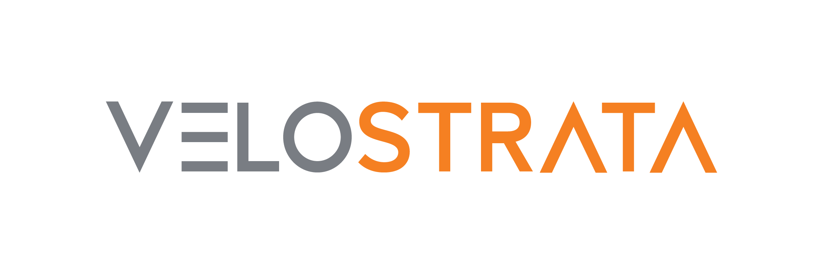




Integrated tools across every stage
Azure Migrate (including ASR)
From Microsoft
Operations
Management Suite
+
Cloudyn
Database Migration
Assistant
Database Migration
Service
Discovery
Migrate
Optimize/Modernize
Our Partners
+ MTA Program
Notes:
Microsoft and third parties have developed a set of tools to assist with each phase of the migration process, from Discovery to Migration to Optimization. In many cases, the third-party tools complement those built by Microsoft. For example, in the Migrate stage, CloudEndure provides support for a wider range of virtual machines and uses a slightly different replication technique that might be appropriate for some organizations. Velostrata is often used when a fast-paced migration of virtual machines is required.
In addition, many other Microsoft services offer consulting services which can provide migration expertise to companies who are new to it.

Slide 11
…transforming existing apps to containers & microservices, with ROI at every stage
1
2
3
4
APP
Containerize the app
Modern infrastructure
Modern methodologies
Modern microservices
10X
OpEx time savings
50%
Infrastructure consolidation
27% More testing automation
13X
Deployment frequency
99%
Faster security VULN MTTR
99%
Deployment time savings
30% More deployment automation
65%
Reduce dev onboarding time
5 min
Average new time to scale apps
99%
Portability/Cloud migrations
27%
More change approvals
Notes:
A microservices architecture takes a monolithic application and breaks it into a collection of modular services, each of which operates independently. The benefit is these microservices can be deployed and managed more easily, and they can be deployed either locally or in the cloud. A first step in moving to this application is containerizing applications, allowing them to run on virtual machines. By containerizing apps and/or transforming them into microservices, the migration to the cloud becomes much easier. Companies that have at least partially adopted this architecture can more easily begin to migrate to the public cloud.

Slide 12

Removing barriers to migrate
A new set of services and offers enables seamless migrations
Azure Migrate
Azure Database Migration Service
Azure Cost Management
Azure Hybrid
Benefit
DataBox
Free for all
customers
Free for all
customers
Free for
EA customers
Windows Server
SQL Server
Large volume
storage migration
Notes:
Microsoft offers a complete set of services and solutions. Many of these services and tools are free to Microsoft customers.

Slide 13
Lift and Shift (Apps, Containers, Virtual Machines, Workloads)
Lift and Shift is great when you
Want to avoid the burden of owning on-premises servers and datacenters. The cost and risk of maintaining the facilities are high.
Want to move to cloud to lower your maintenance costs by taking advantage of cloud infrastructure.
Need a scale-on-demand capacity with no change in application environment needed.
Want to have data disaster recovery in cloud.
Notes:
There are many scenarios under which Lift and Shift is the best approach:
Want to move to Cloud as-is to lower your maintenance costs taking advantage of cloud infrastructure
Want to avoid the burden of owning on-premises servers and data centers.
Need a scale-on-demand capacity with no change in application environment needed.
Need disaster recovery

Slide 14
Migrate apps to Azure
Replicate
Test
Migrate
Plan
Reduce complexity of managing and updating apps with a modular approach.
Reduce TCO and increase ROI
30% TCO reduction on average
Push compute away from centralized nodes and closer to sources of data.
Most .NET apps can simply move to VM-based Docker containers!
Plan Azure infrastructure
Replicate app data to Azure
Test apps before migration
Reduce production downtime during migration
Zero app data loss

Slide 15
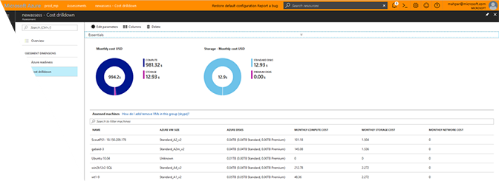
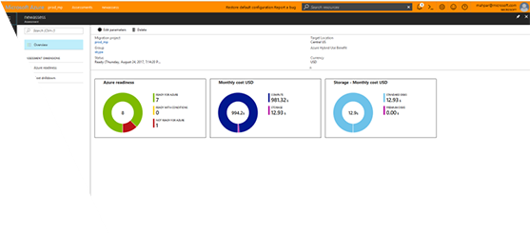
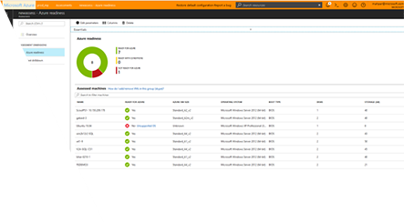
Azure Migrate
Guidance, insights and mechanisms for cloud migration
Discover and assess on-premises virtual machines and servers
Built-in dependency mapping
Intelligent right-sizing for Azure virtual machines & estimated costs
Compatibility reporting with guidelines for remediating potential issues
Migrates workloads through seamless virtual-machine and server replication
Includes machines managed by a vCenter Server, version 5.5, 6.0, or 6.5.
https://docs.microsoft.com/en-us/azure/migrate/migrate-overview
Notes:
To speed the discovery process, you can use Azure Migrate, a new free service from Microsoft that is integrated with Microsoft Azure Site Recovery and Microsoft Operations Management Suite.
Azure Migrate supports discovery of on-premises virtual machines in a VMware environment and recommends Azure Virtual Machine instance types and sizing. The service also provides cost estimates for running a workload in Azure and can map dependencies between virtual machines.

Slide 16
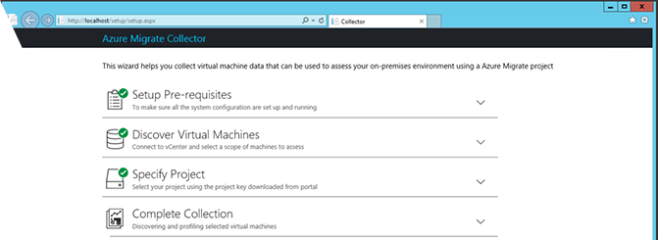
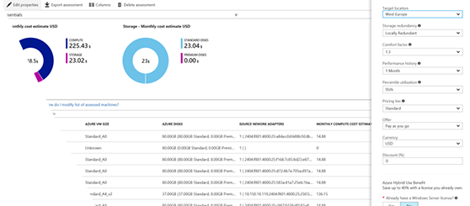
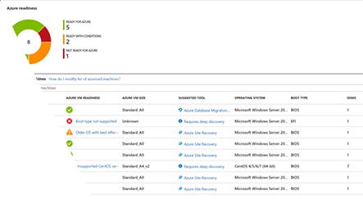
Azure Migrate discovery and assessment
Intelligent right-sizing and analysis
Agentless VM discovery through virtual appliance
Supporting vSphere and Hyper-V*
Windows Server and Linux VMs
Dependency mapping to ensure full visibility of all application VMs
Understand all server and application connections
Discover unknown relationships to ensure thorough migration
Intelligent right-sizing
Recommendations for Azure series targeting indicated utilization (95% default)
Cost analysis
Application group cost analysis for superior budgeting
Region and currency specific
Enabled for Azure Hybrid Benefit for Windows Server
Azure readiness
Deep assessment of virtual machines to determine Azure compatibility
Reporting on VM readiness, suggested configuration updates and migration recommendations
Azure Database Migration Service integration
*Coming Soon
Notes:
Azure Migrate helps companies decide which applications and virtual machines are most appropriate for a proof of concept, and which would be best migrate later. A big part of this is defining dependencies between different services, which would be impacted by a migration. It also helps companies understand what their costs will be and what Azure resources will be needed.

Slide 17
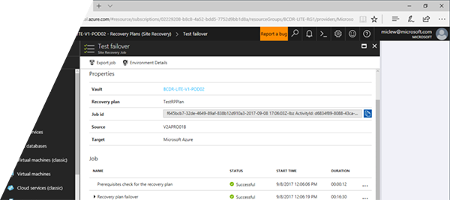
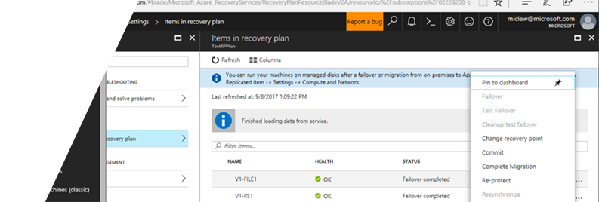
Azure VM and server migration (via ASR)
Flexible and powerful migration tools for anywhere to Azure migration
Model start-up flow and configuration dependencies for concise application migration
Built-in migration testing to ensure expected results
Warm migration with no long outages
Advanced monitoring and analytics enable you to manage performance and utilization
Built into Azure Migrate*
http://aka.ms/asr-dp-hyperv-doc
*Coming Soon
Notes:
Azure Migrate’s server replication, incorporating Azure Site Recovery, handles the actual migration of the services and virtual machines. It models workflows and dependencies to make sure the complete environment is migrated, then tests the result to ensure the migration went as expected.

Slide 18
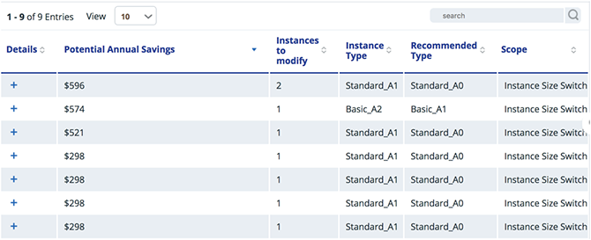
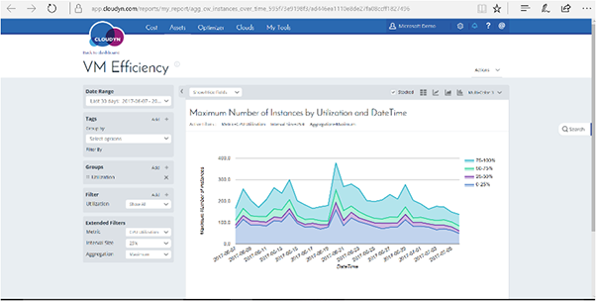
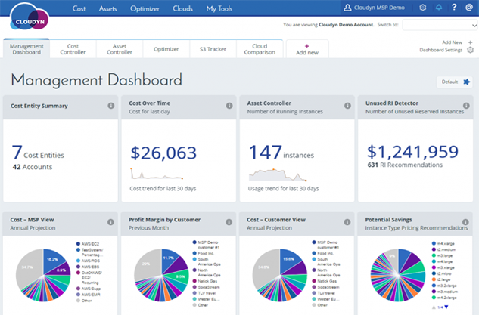
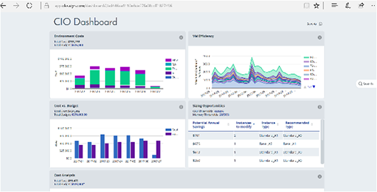
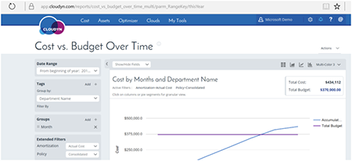
Cost optimization and efficiency (via Cloudyn)
Visibility into resource costs
Visibility into application and departmental costs
Budgeting
Cost optimization with right-sizing guidance
Free to all Enterprise Agreement customers
Notes:
Cloudyn, a recent addition to Microsoft’s suite of migration tools, will appeal to both business managers and IT because it provides detailed visibility into the resource costs of running systems on Azure. Through its reporting interface, organizations can monitor costs split across websites, virtual machines, storage, applications, databases and networks. Cloudyn will ensure migrated virtual machines continue to deliver targeted resource utilization and best cost by recommending changes.

Slide 19







Enterprise Linux cloud infrastructure With Red Hat
Microsoft Azure offers…
Enterprise grade support for all popular Linux distributions
Unique industry leading framework for hybrid implementation
Comprehensive Red Hat support with engineers co-located in Azure support centers
You have already bought Red Hat – find out how to run it on Azure!
Notes:
Azure supports a variety of popular Linux distributions, including Red Hat. If you’ve already bought Red Hat, you can easily run it on Azure too. Many customers already have.
All customers listed on this slide can be externally referenced

Slide 20









Dev/Test for Linux-based workloads With Docker, Chef, Vagrant, Jenkins
Microsoft Azure offers…
Deep support for popular Open Source
Application frameworks (e.g., node.js, Java, Python), including SDKs and cross-platform tools
DevOps solutions like, Chef, Puppet, Jenkins, etc.
DevTest subscription offering for efficient resource management
You need to modernize their DevOps – find out how easy it is on Azure!
Notes:
Examples of Azure’s support for Linux-based dev/test solutions.

Slide 21









Open source data infrastructure With Cloudera, Hortonworks, DataStax
Microsoft Azure offers…
Out-of-the-box managed services for Hadoop and NoSQL databases
Robust and secure IaaS offerings for traditional open source data stores
More datacenter locations for data replication
Support for hybrid data scenarios
You want to consolidate your data investments - find out how to do that on Azure!
Notes:
A key part of Azure’s open platform is support for open source data infrastructure, including open source data stores. Azure supports data platforms such as:
Cloudera, the first and the leading provider and supporter of Apache Hardoop for the enterprise
Hortonworks, a big data software company based in Santa Clara, California. The company develops and supports Apache Hadoop, for the distributed processing of large data sets across computer clusters.
Datastax, a data management company specializing in Apache Casandra
All customers listed on this slide can be externally referenced

Slide 22





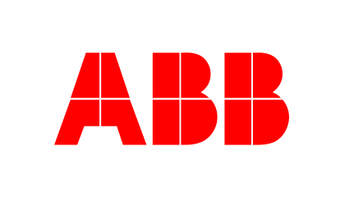


High performance computing With SUSE
Microsoft Azure offers…
Big compute nodes optimized for Linux HPC (A8 - A11)
Key Linux HPC technologies
HPC cluster on Linux (distributed job-scheduling)
InfiniBand (high-speed communication between nodes)
Linux supported RDMA network (for enhancing performance of parallel tasks)
You are heavily invested in Linux HPC - find out what Azure has to offer!
Notes:
For companies wishing to move large Linux clusters into the cloud, Microsoft Suse on Azure.
All customers listed on this slide can be externally referenced

Slide 23
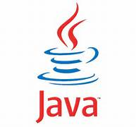
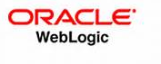
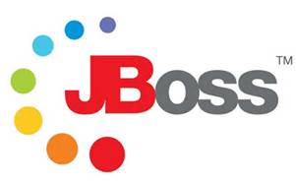






Java Enterprise platforms
Microsoft Azure offers…
Easy development, deployment and automation of Java-based applications using popular tools
Robust IaaS framework for multi-tier Java Enterprise apps – scalability, high availability, unique hybrid support
Broad and deep Java SDK support for all Azure services (for desktop and mobile)
You already use Java – find out why Azure is the best place to run it!
Notes:
If you have applications based on Java, Azure provides broad and deep support for Java Enterprise apps and the Java SDK.
All customers listed on this slide can be externally referenced

Slide 24







LAMP and MEAN powered Web applications With Bitnami, Ubuntu
Microsoft Azure offers…
Broad support for all technologies within the LAMP and MEAN stacks
Automatic scaling through virtual machine scale sets to deal with unpredictable demand
Industry-leading managed services for hosting web applications (Azure WebApps)
Your websites are powered by open source – good reason to move to Azure!
Notes:
If you are running a full LAMP (Linux, Apache, MySQL and PHP/Python/Perl) stack, Azure provides broad support and automatic scaling through VM scale sets.
The same applies to the MEAN (MongoDB, ExpressJS, AhgularJS, and Node.js) Javascript stack, with support from client to server to database.

Slide 25
Cloud Security… Now Primary Driver to Digital Transformation and Cloud Adoption
Software Defined…

Slide 26




Azure Active Directory
B2B INTEGRATION
Facebook
LinkedIn
On-Premises
SOCIAL MEDIA SSO
DIRECTORY SYNCHRONIZATION
Twitter
CUSTOMER IdP
Windows Server
Active Directory
DEVICE MANAGEMENT
SaaS SSO
AZURE ACTIVE DIRECTORY
Azure
Public
cloud
Extend organization identities to the cloud and external services
Designed for a single public domain name
Deep integration with Active Directory
Integrated access management with Microsoft cloud services + 3,000 SaaS apps
External account federation capabilities with AAD B2B service
Advanced capabilities – MFA, PIM, Identity Protection, Conditional Access, Open API

Slide 27

Layered Network Security
Azure
Deployments
VM
Firewall
NSG & UDR
NVA/WAF
LB/NAT
DDoS
Internet
Azure

Slide 28
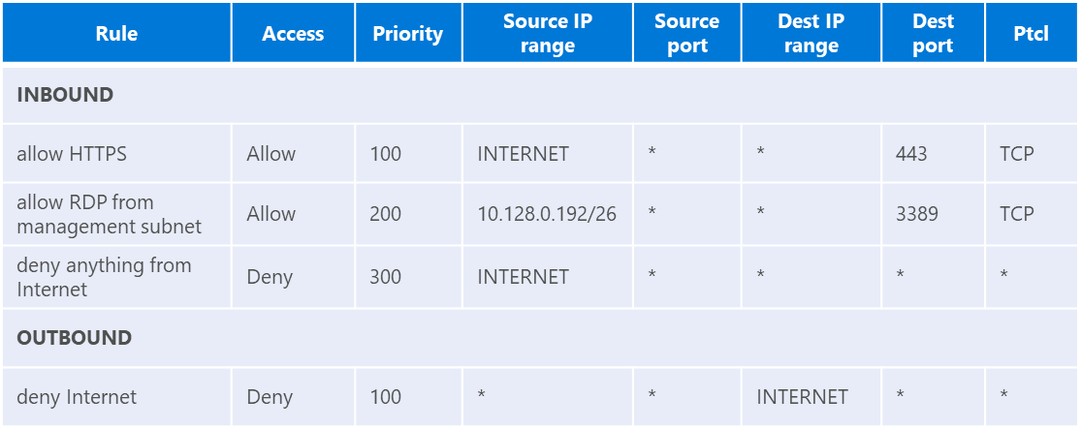
Azure Networking
Internet Gateway
Domain-01: 10.128.0.128/26
WEB
DOMAIN
IN DMZ
EX DMZ
APP
DATA
Notes:
Source: http://aka.ms/guruskill/70-535 => Presentations/2018-01-24-Hartford/70-535_03-Design Network Implementation.pptx

Slide 29
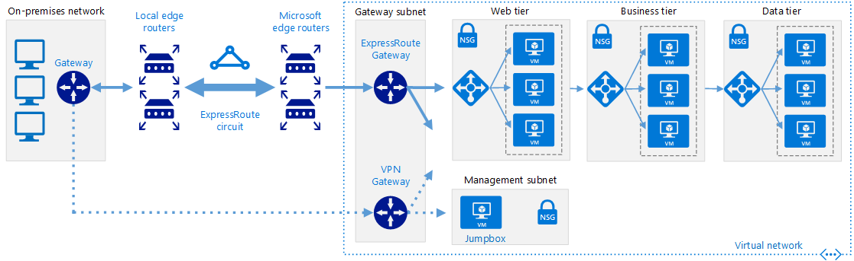
Private Network (ExpressRoute) with failover VPN
https://docs.microsoft.com/en-us/azure/architecture/reference-architectures/hybrid-networking/expressroute-vpn-failover

Slide 30
Building a Hub Network
https://docs.microsoft.com/en-us/azure/architecture/reference-architectures/hybrid-networking/hub-spoke
Route Table
Address Prefix | Next Hop Type | Next Hop IP
10.128.0.0/21 | Virtual appliance | 10.128.9.10
0.0.0.0/0 | VNET Gateway
GatewaySubnet: 10.128.7.0/27
Domain-01: 10.128.0.128/26
DMZ-02: 10.128.0.64/26
DMZ-01: 10.128.0.0/26
FORCED TUNNELING
Local Network Gateway
Management-01: 10.128.0.192/26
DevOps-01: 10.128.1.0/24
SERVICE TUNNELING
https://docs.microsoft.com/en-us/azure/architecture/reference-architectures/hybrid-networking/hub-spoke

Slide 31
Integrating a Spoke Network
https://docs.microsoft.com/en-us/azure/architecture/reference-architectures/hybrid-networking/hub-spoke
Local Network Gateway

Slide 32
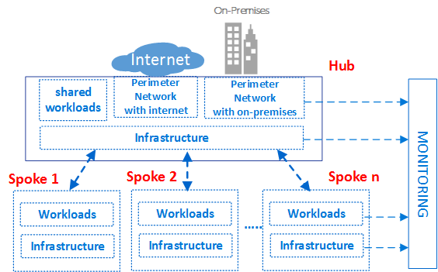
Azure Virtual Datacenter Pattern
Benefits
Eliminate redundancy
Simplify maintenance
Better scalability
Separation of concerns
Reduce cost
Azure Virtual Datacenter Reference
https://docs.microsoft.com/en-us/azure/networking/networking-virtual-datacenter

Slide 33
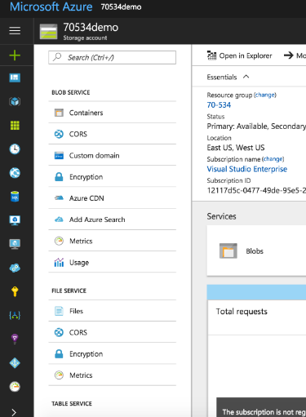
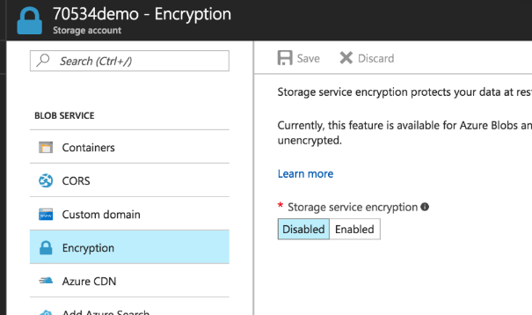
Storage Services Encryption
Notes:
Azure Storage Service Encryption (SSE) for Data at Rest helps you protect and safeguard your data to meet your organizational security and compliance commitments. With this feature, Azure Storage automatically encrypts your data prior to persisting to storage and decrypts prior to retrieval. The encryption, decryption, and key management are totally transparent to users.
SSE works by encrypting the data when it is written to Azure Storage, and can be used for Azure Blob Storage and File Storage. It works for the following:
Standard Storage: General purpose storage accounts for Blobs and File storage and Blob storage accounts
Premium storage
All redundancy levels (LRS, ZRS, GRS, RA-GRS)
Azure Resource Manager storage accounts (but not classic)
All regions.

Slide 34
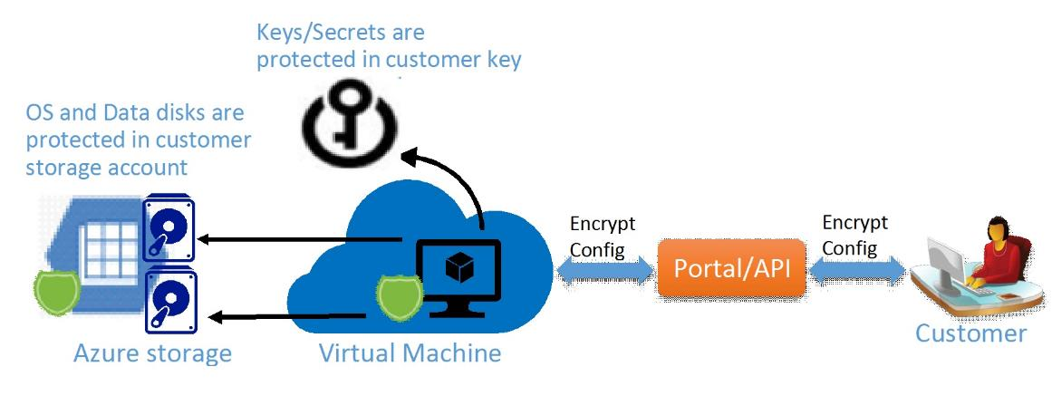
Azure Disk Encryption
Notes:
Azure Disk Encryption is a new capability that helps you encrypt your Windows and Linux IaaS virtual machine disks. Azure Disk Encryption leverages the industry standard BitLocker feature of Windows and the DM-Crypt feature of Linux to provide volume encryption for the OS and the data disks. The solution is integrated with Azure Key Vault to help you control and manage the disk-encryption keys and secrets in your key vault subscription. The solution also ensures that all data on the virtual machine disks are encrypted at rest in your Azure storage.
Azure disk encryption for Windows and Linux IaaS VMs is now in General Availability in all Azure public regions and AzureGov regions for Standard VMs and VMs with premium storage.
When you apply the Azure Disk Encryption-management solution, you can satisfy the following business needs:
IaaS VMs are secured at rest, because you can use industry-standard encryption technology to address organizational security and compliance requirements.
IaaS VMs boot under customer-controlled keys and policies, and you can audit their usage in your key vault.

Slide 35
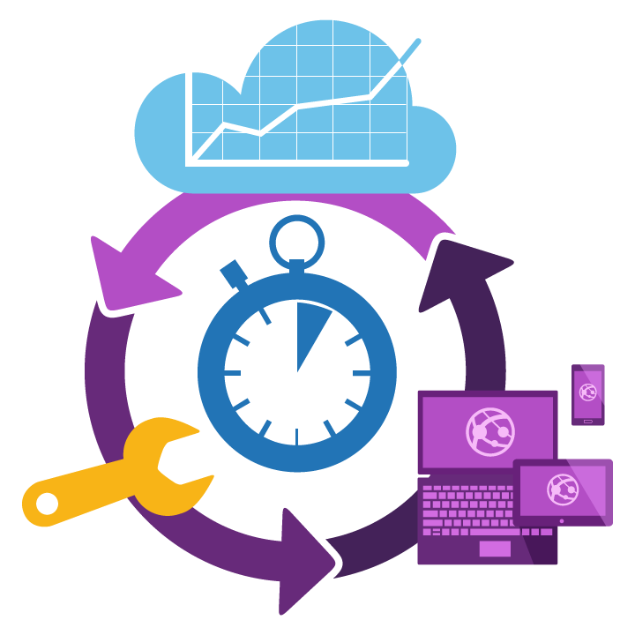
Data Migration
Migrate data and virtual machines for scalability and performance
Continue using instance level capabilities without changing application design with Azure SQL Database Managed Instance.
Scale performance of data workloads by shifting apps to the cloud on Azure SQL Database.
Shift OSS VMs and apps to the cloud using Azure Database for PostgreSQL and Azure Database for MySQL.
Shift MongoDB, Graph, Cassandra apps to the cloud using Azure Cosmos DB.
Notes:
Customers consider app modernization for a few reasons.
They want to leverage Cloud native technologies (born in the cloud). Examples are Serverless: Function, LogicApps.
They want to extend their existing apps (e.g. add new features, capacity) to benefit from the emerging AI tech, such as ML, AI, Bot…etc.
They want to mobilize their workforce, and have to mobile-ready their internal apps.
Finally, their dev teams would need seamless, modern, constant CI/CD capability to improve productivity and cut cost.

Slide 36
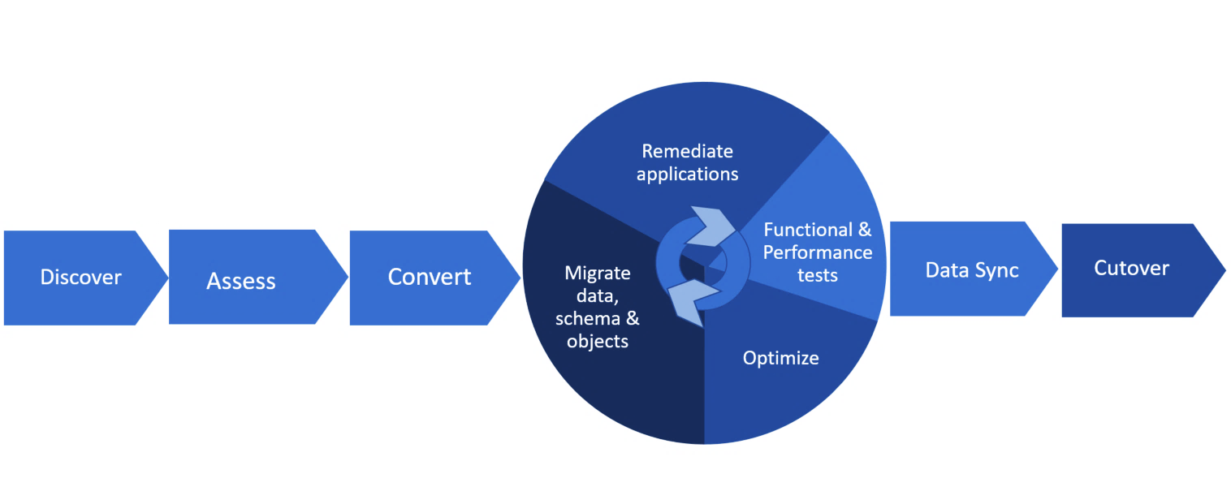
The migration lifecycle
Notes:
As with the application and VM migration discussed earlier, data migration includes a discovery/assessment stage, then the migration itself, which includes conversion of the data, remediating any compatibility issues, migrating the data and scheming, then optimizing. After testing, the data can be synced and then the organization can cut over to the Azure database.

Slide 37
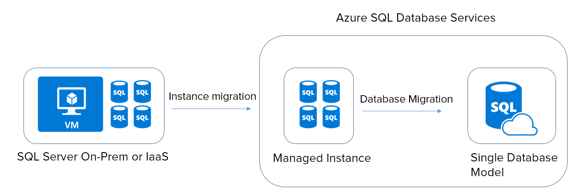
SQL Server migration example
More Control
More Isolation

Slide 38


Data migration tools and services
Assess
Migrate
Microsoft Data Migration Assistant
Rich assessments at scale
Feature recommendations
Schema conversions
Azure Database Migration Service
Microsoft and non-Microsoft source support
Built for scale and reliability
Built with enterprise security and privacy
Notes:
The Data Migration Assistant helps with the discovery and assessment stage, then the Migration Service is used to migrate the data, schema, etc. It works with SQL Server as well as Oracle and MySql.
DMA – Built by SQL Engineering team with latest and greatest knowledge base of all SQL versions. This helps with assessing and planning.
DMS – Newest offering, Azure service that helps you move your on-prem DBs to Azure at scale.

Slide 39
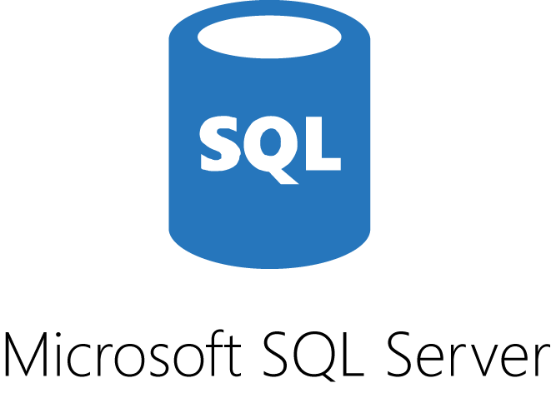

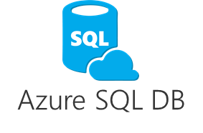


Data Migration Assistant: Assess and migrate schema
1. Assess and identify issues
3. Convert and
deploy schema
Legacy SQL Server Instance
DMA
2. Fix issues
Notes:
Data Migration Assistant enables discovery and assessment of current data environment, identifies compatibility issues, and recommends performance and reliability improvements

Slide 40
Azure Database Migration Service
SQL DB
Streamline database migration to Azure
Managed service platform for migrating databases
Migrate SQL Server and third-party databases to Azure SQL Database
Oracle
SQL
https://docs.microsoft.com/en-us/azure/dms/dms-overview
Accelerating your journey to the cloud
Notes:
As organizations look to optimize their IT infrastructure so they have more time and resources to focus on business transformation, Microsoft is committed to accelerating these initiatives. Database Migration Service helps migrate existing on-premises SQL Server, Oracle, and MySQL databases to Azure SQL Database, Azure SQL Database Managed Instance or SQL Server on Azure virtual machines.
Deployment options will include Azure SQL Database and SQL Server in Azure VM.
Managed service platform for migrating databases
Azure SQL DB and Managed Instance as targets
Competitive DBs – Oracle and MySQL
Meets enterprise non-functional requirements (NFRs) – Compliance, Security, Costs, etc.

Slide 41
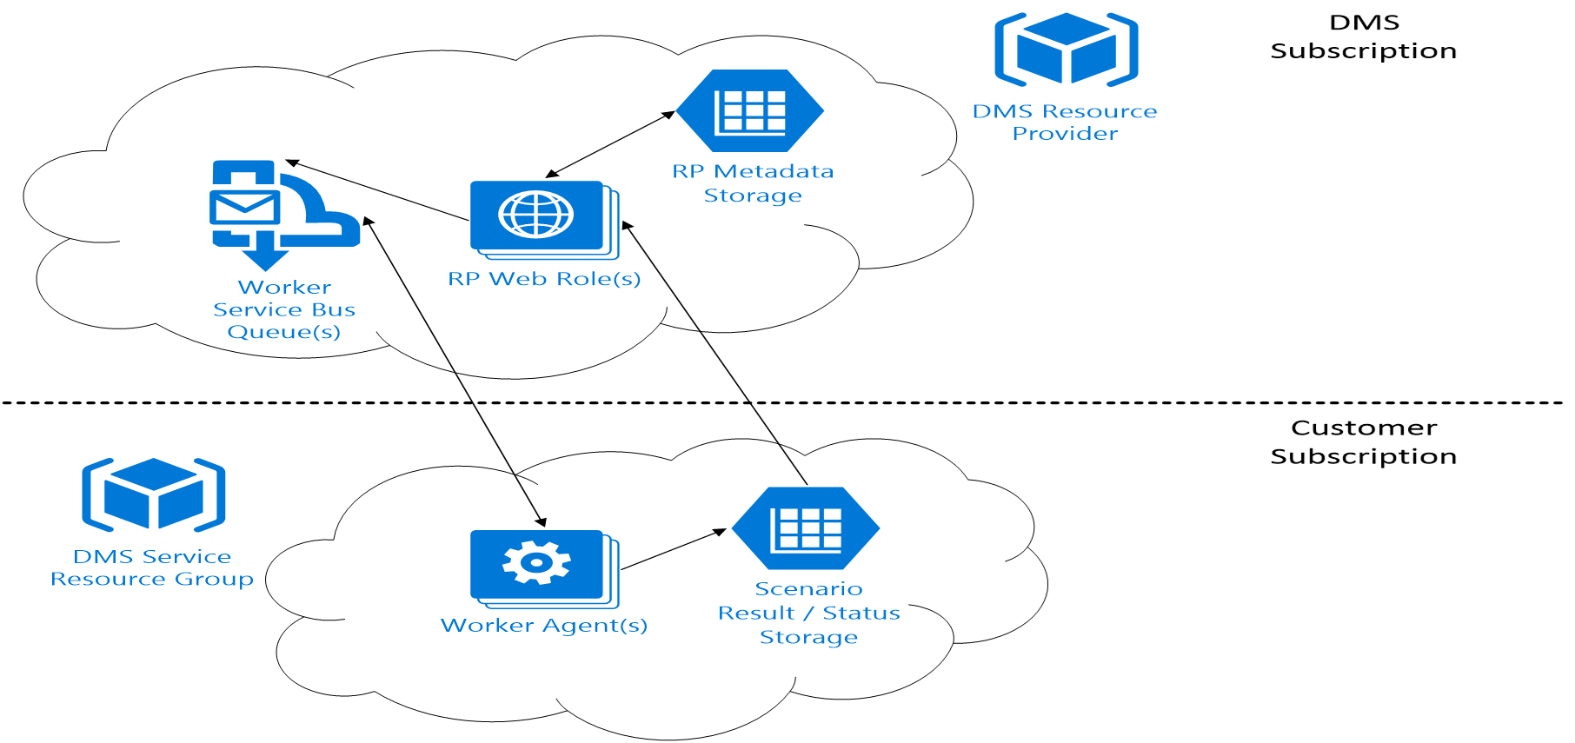
Database Migration Service architecture
VPN Tunnel/Express Route

Slide 42
SQL Database Managed Instance
it’s a real game changer
Migrate SQL Server databases without application re-architecture
Application surface compatibility:
SQL Agent, SQL Profiler
Cross database references and queries, CLR, Replication, CDC, Service Broker
Database sizes up to 35 TB
Minimum downtime migration
Azure Database Migration Service
Native backup/restore and log shipping
Security isolation with Azure VNet
Unmatched app compatibility
Unmatched PaaS capabilities
Economical to ensure best ROI
* preview
Notes:
This is new deployment option in preview within Azure SQL Database called Managed Instance.
Managed Instance offers near 100% SQL Server compatibility with the benefits of platform as a service! This includes features like SQL CLR, SQL Server Agent and cross-database querying. If you can imagine a managed SQL Server environment where you continue using instance level capabilities without changing your application design – it’s a real game changer. Managed Instance is currently in private preview, during which we’ll work with early adopter customers to make sure we satisfy the “lift and shift” requirements for the widest set of existing applications.
Fully-fledged SQL instance with nearly 100% compatibility with on-premises
Learns and adapts with customer apps
Competitive, Transparent and Frictionless

Slide 43

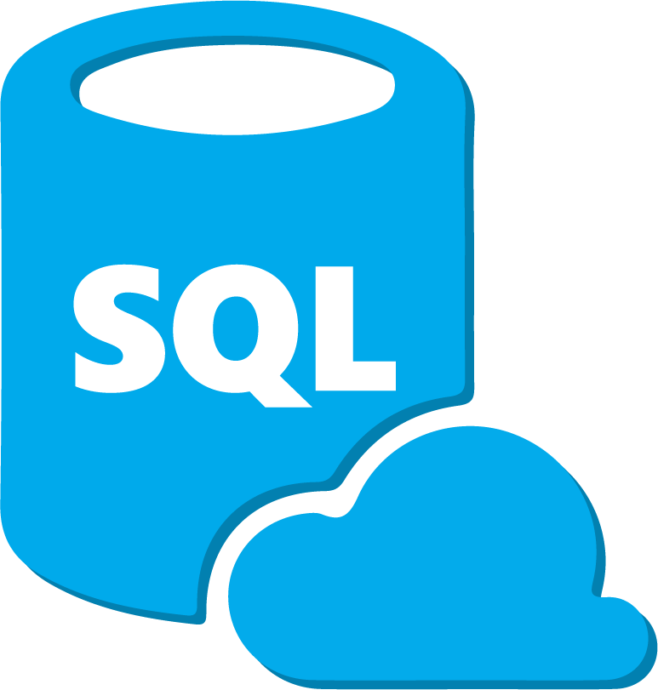



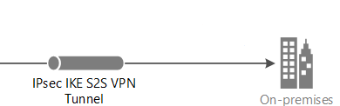

SQL Database Managed Instance connectivity
Network isolation (customer VNET)
Tenant isolation (compute, storage)
VNET1
SQL Instance #1
VNet-to-VNet
Web app (public IP)
SQL Instance #2
SQL Instance #3
VPN / Express Route
Gateway
storage account
“Database bubble” dedicated to customer X
(virtual private cluster, VNET, private IPs)
SQL DB regional endpoint
Other customer bubbles

Slide 44
The modern data estate
HYBRID
On-premises
Cloud
Operational databases
Operational databases
Data warehouses
Data warehouses
Data lakes
Data lakes
Reason over any data, anywhere
Flexibility of choice
Security and privacy
Notes:
Power your entire data estate with SQL Server 2017 and Azure Data Services
Now we’ll look at all the reasons why Azure Data Services, along with SQL Server, are the right data management and analytics solutions for your cloud data estate. Only Microsoft can provide a consistent experience for all these workloads, from on-premises to the cloud. Any language, any platform, anywhere.
Data Sources
Azure Data Services has a variety of data management and analytics tools for all your data needs. It can store structured and unstructured data, whether it’s born in the cloud like sensor and social, or perhaps different data altogether like media.
Data Management
Azure SQL Database is the cloud answer to managing your operational data, with the ability to achieve infinite scale. It’s built on SQL Server, so your existing applications and skills transfer. And as a managed database service, it can save you time and money in both set-up and administration.
Azure SQL Data Warehouse is the industry’s first enterprise-class cloud data warehouse that can grow, shrink, and pause in seconds. Based on the proven SQL Server relational database engine, it gives petabyte scalability with massive parallel-processing architecture that enables distributed processing to handle the rigors of modern data realities. It independently scales compute and storage in seconds.
SQL Data Warehouse works seamlessly with Power BI, Azure Machine Learning, HDInsight, and Azure Data Factory.
Azure Data Lake - Offers data management and analytics at scale to customers, as Azure Data Lake. It is composed of three parts:
Azure Data Lake Store, Azure Data Lake Analytics, and HD Insight. Together with these products, you can store big data of any size and type, and analyze it with familiar open-source tools – all while getting a leading, enterprise-class SLA.

Slide 45
SAP on Microsoft Azure
Consider enterprise integration when
Your on-premises infrastructure is key to the business, and a major investment, but the benefits of a cloud approach are becoming too great to ignore.
Certain auditability or compliance requirements prohibit putting some applications in the cloud. You need a secure, seamless way to integrate all apps and services easily.
De
You plan to create more B2B apps and integrate multiple third party services into your LOB apps, on premises or in the cloud.
Notes:
Out of necessity or comfort-level, many organizations still need to support various on-premises applications and services – but they can still leverage the cloud for many workflows. Microsoft’s enterprise integration capabilities make this possible.
BizTalk Server 2016 connects seamlessly to Azure Logic Apps and to other Azure services, giving you all the benefits of the cloud while still maintaining whatever IT assets might be required to be managed on-prem
Azure API Management connects to back-end services hosted anywhere, and Azure Logic Apps has many out-of-the-box connectors to enterprise SaaS providers
We are investing heavily in features to stay ahead of the curve in this critical area of enterprise services

Slide 46
Modernize your SAP environments
SAP NetWeaver applications certified on Azure Infrastructure for production and non-production
Dev/Test. Demo and Training
Disaster Recovery
Archiving
Production
Advanced Analytics on SAP Data
40-75%
Provisioning in minutes, not weeks/months
60%
Use Azure Machine Learning, Power BI for insights and intelligent actions from existing data
TCO cost savings for dev/test
less storage costs for archiving data
Notes:
Moving to HANA might be on the top of CIOs minds these days, but modernizing SAP environments doesn’t have to be just about the move to HANA. By bringing the benefits of the cloud into your SAP landscapes, you achieve significant cost savings and agility. This gets you one step closer to transformation even if you are planning on HANA transition down the road.
Azure has a wide set of SAP Netweaver certifications for production and non-production scenarios so you can take immediate advantage of the cloud scale, speed and economics.
For instance, you can run your Dev/Test for SAP environments on pay-as-you-go VM infrastructure and save 40-75% on TCO. You can implement DR in Azure with out-of-the-box DRaaS capabilities of Azure. This differentiates Azure from other public cloud providers.
You can use cheap and reliable storage to save your enormous SAP historical data for archiving or compliance purposes. Of course, you can run your production environments in Azure as well and free up Datacenter capacity or consolidate DCs.
On top of all the cost efficiencies and agility, you can also take advantage of Azure services like ML to drive insights from your business data and optimize your business processes with the new-found intelligence.

Slide 47
Your SAP HANA options on Azure
G-series VMs
for Dev/Test and PoC
M-series VMs
for most implementations
SAP HANA Large Instances for extreme scale and performance
On-demand infrastructure
Purpose-built infrastructure
Up to 0.5TB RAM
Globally available
Up to 3.5TB RAM
Available by end 2017
Largest scale (up to 20TB RAM*)
Up to 4 TB available in US, EU, AU
*4-20 TB instances available soon
Notes:
In Azure, we’re invested to give you highly scalable and performant infrastructure if you’re embarking on HANA.
Azure has virtual machines for dev/test, POCs as well as certified by SAP for production. They provide pay-as-you-go infrastructure with full certification for HANA and support upto ½ TB of RAM.
But we know SAP HANA systems can explode pretty quickly. So we’ve built specific hardware to give you unparalleled scale and performance. Called SAP HANA Large Instances they’re based on purpose-built infrastructure for HANA, are fully managed with 99.99% SLA and have up to 4 TB RAM per node today. We’ve been increasing this over time, and will continue to do so, so you’re HANA applications future-proof from a scale/performance POV. Currently available for production in the US, we’re building these out in AU and EU as well to be ready within next 6 months.
We’re also investing in VMs that are capable of handling large HANA workloads. We expect Z-series VMs to be certified by SAP by end 2017, which will then sport up to 3.5TB RAM per node. We will launch M-series in three waves:
Wave 1 (all before end of CY17): US East 2, US West, West Europe, UK South, Australia East, Australia SE, JPN East, JPN West
Wave 2 (in CY18): India, Canada East and Canada Central
Wave 3: Other regions - Gov Cloud, Singapore, UK West, W Europe. No timeline here yet.

Slide 48


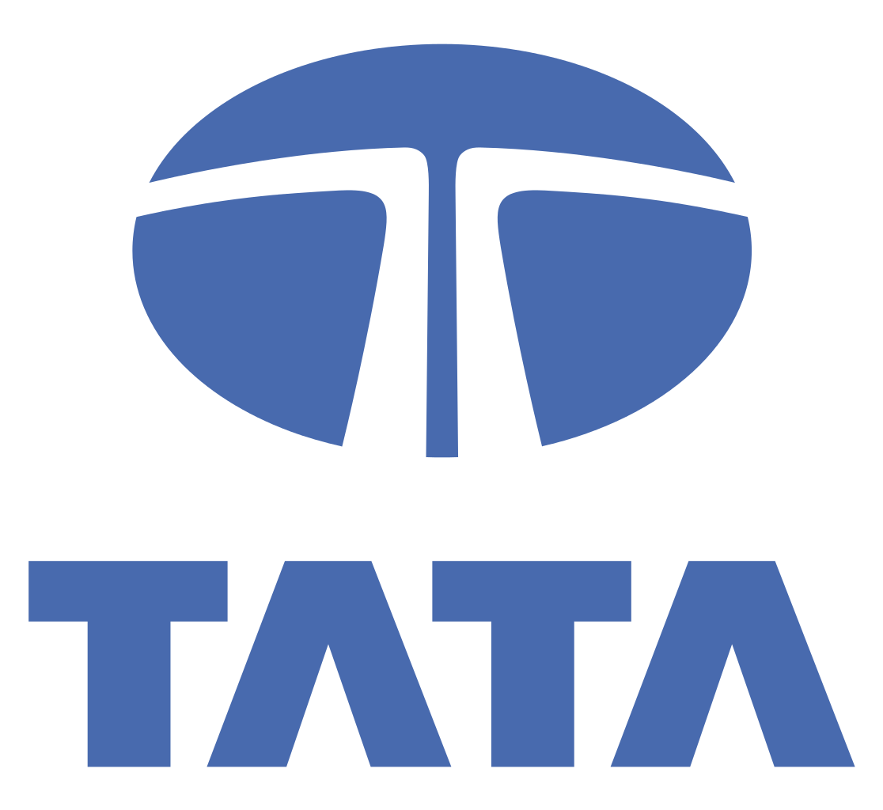
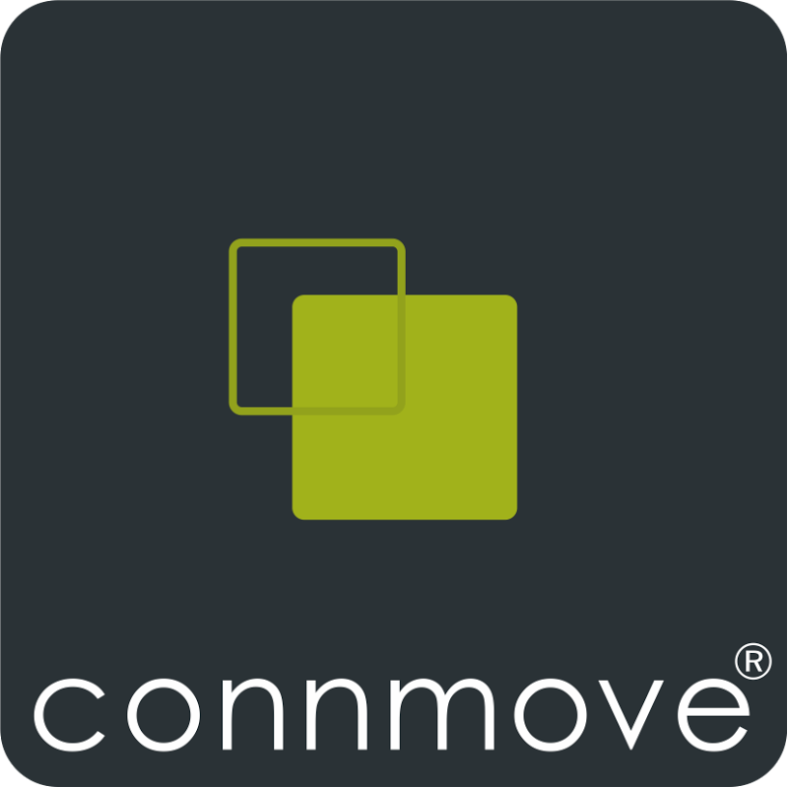













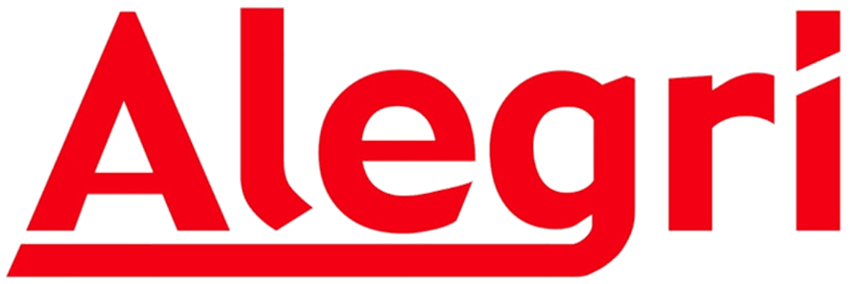
SAP on Azure Partners
Notes:
With Azure, you’re become the beneficiary of a longstanding deep partnership between two companies that gets the enterprise – MSFT and SAP.
20+ years of deep partnership serving the same enterprise customer base
SQL is No. 1 DB for SAP
SAP betting on Azure with SuccessFactors
Microsoft investing in creating in-house SAP expertise to advise customers, help design and deploy workloads.
<CLICK>
In addition to us working with SAP, we’re bringing an ecosystem of SAP SIs across the globe for your projects.
Microsoft Azure commitment
To provide you the most performant and scalable cloud for your SAP applications including HANA
As you plot these journeys toward HANA and the Cloud, MSFT is support you on this transformation.
We’re committed to be market leader in enterprise class support SAP HANA

Slide 49
Why Azure for SAP workloads
Deep partnership between SAP and Microsoft
Most powerful and scalable cloud for SAP HANA
Enterprise-proven + most secure
20+ year partnership
SAP is betting on Azure for SuccessFactors
Azure is SAP certified for NetWeaver Suite and SAP HANA
Building a strong SI ecosystem together
Microsoft is investing in creating in-house SAP expertise
Differentiated strategy spanning VMs and purpose-built infrastructure
Largest SAP HANA workloads (up to 20TB of RAM) of any hyperscale public cloud provider, bigger than AWS
Scaling out to 60 TB RAM for HANA OLAP, with single-node support up to 20 TB for HANA OLTP
Largest compliance portfolio— 54 compliance certifications
Best platform for digital transformation—take advantage of high-level services like IoT, data, Machine Learning, Power BI for insights
Broad Database support: As you prepare for HANA, you can bring in your existing applications using Oracle or SQL Server

Slide 50
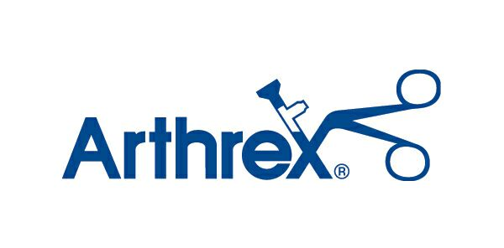
Business case
Pre-Migration Concerns:
SAP environment was hosted at a co-location provider
Environment was not highly available and no disaster recovery solution
Environment was not well monitored
Arthrex Objectives:
Re-platform and migration of SAP system to Azure
Implementation of SAP High Availability
Implementation of Disaster Recovery and Planning
Migration to Suite on HANA (ECC, BW)
Upgrade of SAP systems; to include GTS, BOBJ
Notes:
Arthrex is a global orthopedic medical device company, with main locations in Florida, California, and Germany
The concerns and issues they were seeking to solve by moving to the cloud included:
Arthrex’s objectives for migrating to the cloud included:
ECC is an ERP Software / Solution provided by the company SAP SE. And ECC stands for ERP Central Component and ECC is a term confined to SAP alone.
SAP Global Trade Services (GTS) is software that allows companies to support and define import and export trade processes in SAP ERP

Slide 51
Design considerations, challenges
Pre-migration
Assess the on-premises environment
Plan for the environment in the cloud
Migrate with minimal downtime to production application
Post migration
Disaster Recovery in the Cloud
Notes:
The decision to go to Azure was influenced by the platforms ability to address some key per and post migration Considerations
Assess the on-premises Environment
What method would be used to get the Arthrex’s Workload to Azure, would it be replication , backup and restore or rebuild
If a replication was chose.
How much network bandwidth is required to replicate the servers
How many virtual machines can be move at a time based on Bandwidth?
Plan the environment in the cloud
The key question here was, what compute and storage resources would be need to ensure no degradation in performance once migrated
The timelines, for moving from the Hosters environment were extremely aggressive and owing to the Critcal Nature of SAP to there core business
Could Migration be accomplished, without impacting production

Slide 52






Architecture of phased migration – ASR on-premises to Azure
Customer Current Datacenter (On-premises)
Customer Azure Subscription
`
retire
retire
retire
Azure IaaS/VNET (W EU)
ERP ASCS Prod (Cluster)
ERP APP (HA & Scale)
BW, BO, APP (HA & Scale)
Test/Dev/Prod App Tier (VMWare, single instance)
Migration to Azure (System Copy)
Shut down
Shut down
Shut down
OpenText, PI, NW, Lumira GRC, Paymetrix
Test/Dev/Prod Data Tier (VMWare, SQL server, single instance)
***
SQL Server Log Shipping
Shut down
ASR Process Server
ERP DB
BO DB, etc
(Always On
SAN Storage
Azure Virtual Network Or ExpressRoute (10Mbps -1Gbps)
Web Dispatchers (Scale)
Marketplace NAVs
Net Scaler LB
Check Point FW
Internet
(HTTPS)
Azure Storage
Azure Site Recovery
End users
* ASR moves everything, including SAN configuration which will cause false errors upon migration so a few more steps to configure/script
Notes:
Via Azure Site Recovery, the on-premise SAP servers were replicated to the Recovery Services vault in Azure Storage, the Azure virtual machines were created with the ASR failover plan, and the on premise systems were shut down and retired. Because ASR does a complete replication of all data on the each VM disk from on-premise, it includes the configuration settings. This is a benefit for SAP as it carries over the custom and complex configurations required, but it also will keep things like SAN configuration which will cause false errors upon migration. So be sure to note that this will happen as well.

Slide 53

















SAP NetWeaver on SQL Server + BW on HANA – All in Azure
SIOS Cluster running SAP ASCS HA
Scale out when needed
3
Azure ILB w/ AV for HA SLA
DS13v2
5
4
Azure IaaS/VNET (W EU)
HANA on Azure Large Instances
7
1
768GB HANA S72 Large Instances
ExpressRoute
ERP ASCS Prod (Cluster)
ERP APP (HA & Scale)
BW, BO, APP (HA & Scale)
10Gbps NW provided by MS
OpenText, PI, NW, Lumira GRC, Paymetrix
BW HANA DB
ER
***
Customer Corporate Network
ER
6
SQL Server AlwaysOn (HA) DS14v2, Prem Disk
ERP DB
BO DB, etc
(Always On
MPLS WAN
Web Dispatchers (Scale)
Marketplace NAVs
Net Scaler LB
Palo Alto
FW
9
2
VMs in AV w/ Net Scaler LB for HA & scale
Log Analytics
Azure
Backup
Security Center
Premium Storage &
Managed Disks
On-premises Data Center
(Co-Lo Provider)
ER
Azure IaaS/VNET (N EU)
ER
Recovery Services Vault
Internet
8
8
***
Azure to Azure Site Recovery
Notes:
Here you see the entire architecture of the SAP environment on Azure for Arthrex
Express Route was connected to the customer’s MPLS network to provide consistent and performant connectivity to the SAP environment for their internal users.
Palo Alto firewall and Net Scaler Load balancers were deployed from the Azure marketplace into a DMZ subnet for Internet users to access the Web and Application systems. Azure external load balancers deployed in front of the Palo Alto FWs and Net Scaler devices for content routing between the DMZ and the web and application servers.
The Web , ERP, BW, BO, and other application layer servers were deployed in availability sets with internal load balancers to provide high availability and scale for the customers user load.
Now on Azure cloud, the Web and ERP and BW VMs can be easily scaled out as needed for user load either manually or automatically
The SAP Central Services layer was deployed in a multi node cluster using the SIOS Datakeeper solution to provide the shared disk for the SAP enqueue service and with an Azure ILB with HTTP probes for failover routing for HA
The SQL Server VM are deployed in Always On Availability Groups and on Premium Disks
SAP HANA Large Instance was also deployed as part of the solution. This Large Instance is a physical server deployed in the Azure data center.
The VMs are deployed in the West Europe region and are protected via ASR to the Recovery Services Vault in the North Europe region for DR
The environment is also using Azure Backup for additional in-region resiliency and OMS Log Analytics and Security Center for system and security monitoring they didn’t have before at their previous co-location provider.

Slide 54
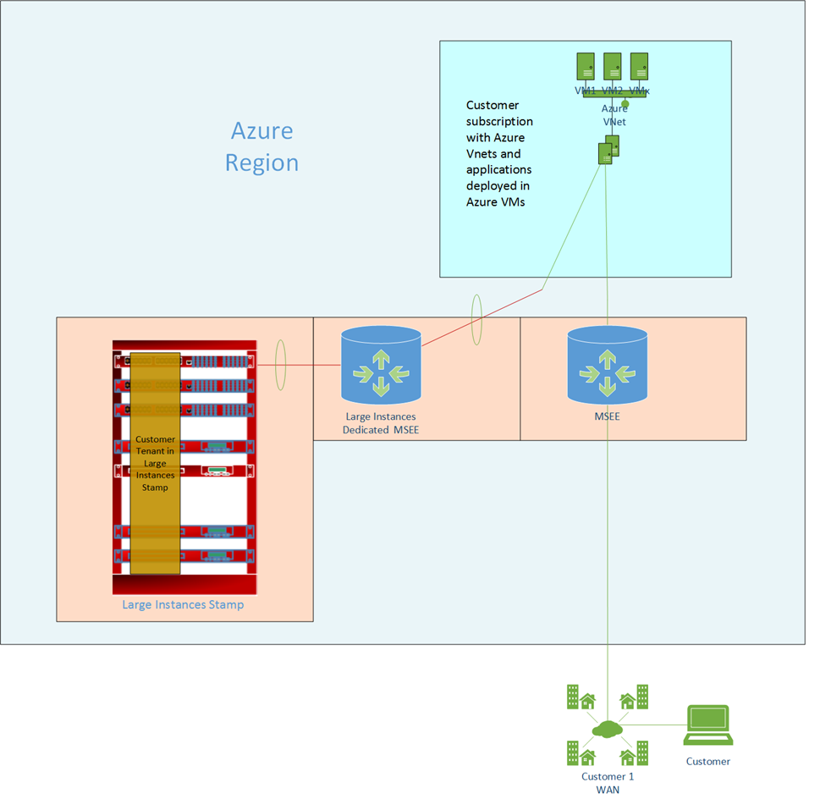
SAP HANA on Azure
Approach
SAP BW on SAP HANA, SAP Business Suite on HANA, and S/4HANA running on purpose-built SAP HANA on Azure large instance hardware.
Solution
Large Instances: for production and non-production workloads
Microsoft offers certified SAP HANA capabilities via purpose-built hardware specifically tuned for SAP HANA.
SAP HANA instance runs in a non-virtualized environment on SAP HANA TDI certified hardware in an Azure-certified data center
SAP HANA is connected to the SAP application tier running on Azure VMs
The two environments are connected via Azure ExpressRoute
¹ in controlled availability
Notes:
SAP HANA is compute intensive and requires specific hardware configurations as certified by SAP. Azure provides a solution via our SAP certified, physical HANA large instances.
The SAP HANA Large Instance physical server is connected to the customer’s virtual network via an Express Route circuit that is included in the Large Instance offering deployment. The Large Instance must be deployed in the same Azure region as the VNET hosting the virtual machines that make direct calls to HANA.
This Express Route circuit is in addition to the ER circuit the customer has between their Azure Virtual Networks and their on-premise network.

Slide 55





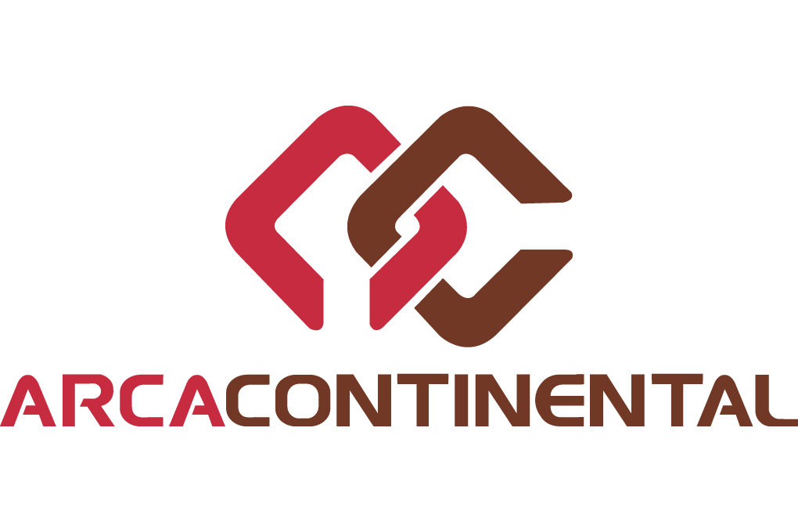




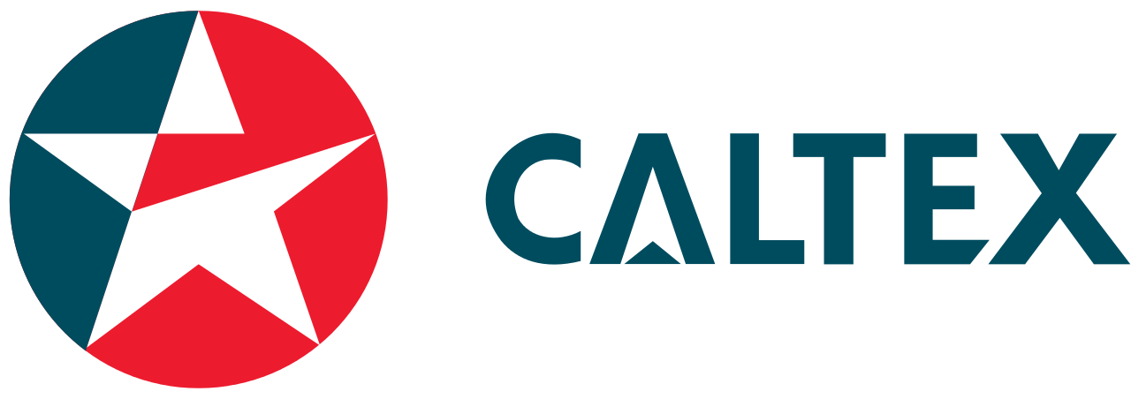

















SAP on Azure customers

Slide 56
Why Azure
Application innovation
Power of PaaS and IaaS with global scale
Data and intelligence
Powerful analytics delivering intelligence
Open + Flexible
Windows and Linux, true hybrid-enabled
Trusted Cloud
Most comprehensive compliance and data privacy
Notes:
Let’s take a moment to understand why Azure is a perfect place for you SAP environments.
With Azure, you can
1. Accelerate app innovation through rapid app development and agility in the cloud.
2. Delivers integrated data and intelligence—data for rich insights to intelligence embedded within apps.
3. Run it all - open and flexible, where you can use the tools and technologies you already have and want to use. Hybrid is a core tenet for Azure
4. Not worry about security or compliance – 52 compliance certifications

Slide 57
Next steps
Azure Migrate call to action
Notes:
The Azure Virtual Machines Readiness Assessment tool automatically inspects your on-premises environment, determines whether it is physical or virtualized, and provides you with a check list and detailed report on steps you need to take to move your environment to the cloud. The detailed report offers expert guidance and advice tailored to your environment.
The Azure Total Cost of Ownership calculator will estimate the cost saving realized by moving applications to Azure. The latest enhancements of the tool include improvements to input, modeling and analysis.

Slide 58
Resources
Get started with information and tools www.azuremigrationcenter.com
Whitepapers
Use cases
Proof of concept guide

Slide 59
Thank you

